Slide 1
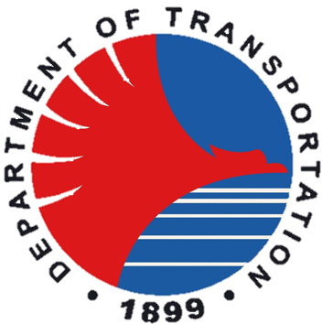








JOIN US !
As part of the Philippines’ Public-Private Partnership Program,
the Department of Transportation will be inviting passenger rail operators to bid for the operation and maintenance of the 147-km North-South Commuter Railway and the 33-km Metro Manila Subway
Both lines are under construction.
Financed by the Asian Development Bank and the Japan International Cooperation Agency.
First Partial operations in 2027.
Full operations targeted by 2032.
The lines are each expected to serve over 500,000 commuters daily.
Travel time projected to be significantly reduced between Clark, Pampanga, and Calamba, Laguna as well as within Metro Manila.
Freepik.com

Slide 2
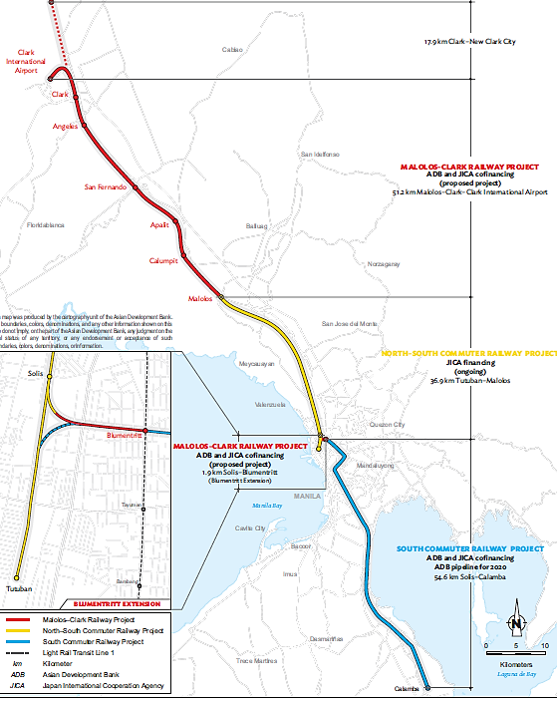


NORTH–SOUTH COMMUTER RAILWAY [ NSCR ]
147-km elevated line connecting Clark International Airport and Calamba, Laguna passing through Metro Manila
35 stations, 3 maintenance depots, and 1 central Operations Control Center
ETCS Level 2 Signaling with ATO
GoA2 Operation with driver
Electro-Mechanical Works carried out by Hitachi and Mitsubishi
408 EMUs manufactured by J-Trec & Sumitomo
EPC financed by the Asian Development Bank and the Japan International Cooperation Agency

Slide 3
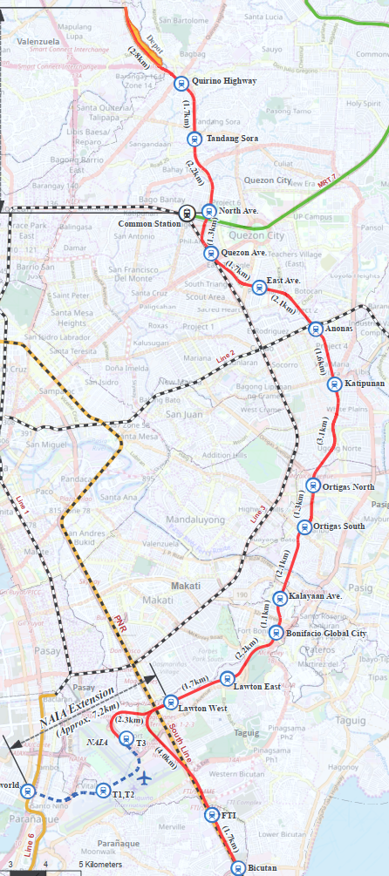
METRO MANILA SUBWAY [ MMS ]
33-km subway line connecting Valenzuela City and Paranaque City in Metro Manila with a link to the Ninoy Aquino International Airport
15 stations, 1 maintenance depots, and 1 central Operations Control Center
MMS trains will interoperate with NSCR in the NSCR Bicutan-Calamba section
CBTC Signaling with ATO on MMS tracks
Rolling Stock are dual-fitted with ETCS and CBTC equipment
GoA2 Operation with driver
Electro-Mechanical Works carried out by Mitsubishi
240 EMUs manufactured by J-Trec & Sumitomo
EPC financed by the Japan International Cooperation Agency

Slide 4

TRANSACTION HIGHLIGHTS
Two (2) separate O&M concessions for the North-South Commuter Railway and Metro Manila Subway.
15-year concession term reckoned from the start of full operations.
Availability payments will be paid to the O&M Concessionaires, subject to attainment of defined key performance indicators.
Bid parameter based on the lowest availability payment.
The O&M Concessionaires will develop commercial business within the lines and retain the revenues therefrom, with a revenue share for the Grantors.
The O&M Concessionaires will be selected via international competitive public bidding and in accordance with the Philippine PPP Code.
No foreign ownership cap for firms in the Philippine railway industry.
Freepik.com
KEY DATES
Investor roadshow: Aug 2025
Tender launch: Q4 2025

Slide 5



CONTACT US FOR MORE INFORMATION
Timothy John Batan
Undersecretary for Railways
Department of Transportation
tr.batan@dotr.gov.ph
Dionisio Camangon II
Senior Markets Development Advisory Specialist
Transaction Advisory Team Lead
Asian Development Bank
dcamangon@adb.org

